Slide 1


┓
Fooling neural networks
Team member: Ruonan Hao, Mingjia Chen, Shuhui Huangn
Notes:
Hello everyone, today we are going to introduce our group project for cs289, which is fooling neural networks. And our team members are Ruonan Hao, Mingjia Chen and Shuhui Huang. The motivation of the project is to make the neural networks more robust, since neural nets are always sensitive to noises.

Slide 2
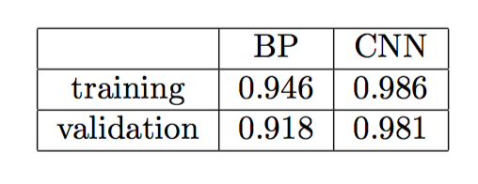
BP Net
ConvNet
PK
The algorithm repeats a two phase cycle, propagation and weight update. When an input vector is presented to the network, it is propagated forward through the network, layer by layer, until it reaches the output.
ConvNet architectures make the explicit assumption that the inputs are images, which allows us to encode certain properties into the architecture. These then make the forward function more efficient to implement and vastly reduce the amount of parameters in the network.
Backpropagation Network
Convolutional Network
MNIST dataset
classifier accuracy for ordinary training
Notes:
We mainly use two kinds of neural networks to train our dataset, one is Backpropagation Network and the other is Convolutional Network. Here we will not explain in detail about how we constructed them, which is shown in our write-up, instead, we just talk about our results. We used MNIST dataset to train, and we found that both training and validation dataset could achieve high accuracy with BP and CNN networks.

Slide 3

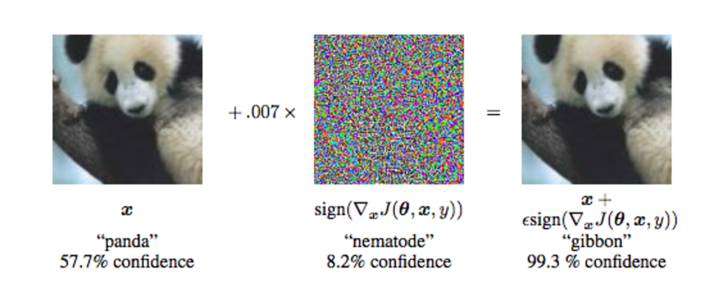
ADVERSARIAL EXAMPLES
Take a correctly classified, and add a tiny distortion to fool the neural network with the resulting image.
what is adversarial examples?
Inputs formed by applying small but intentionally worst-case perturbations to examples from the dataset, such that the perturbed input results in the model outputting an incorrect answer with high confidence.
Notes:
In order to fool neural network, we should add noises to the original images, one special kind of transformed images is adversarial example. It is defined as inputs formed by applying small but intentionally worst-case perturbations to examples from the dataset, such that the perturbed input results in the model outputting an incorrect answer with high confidence.

Slide 4
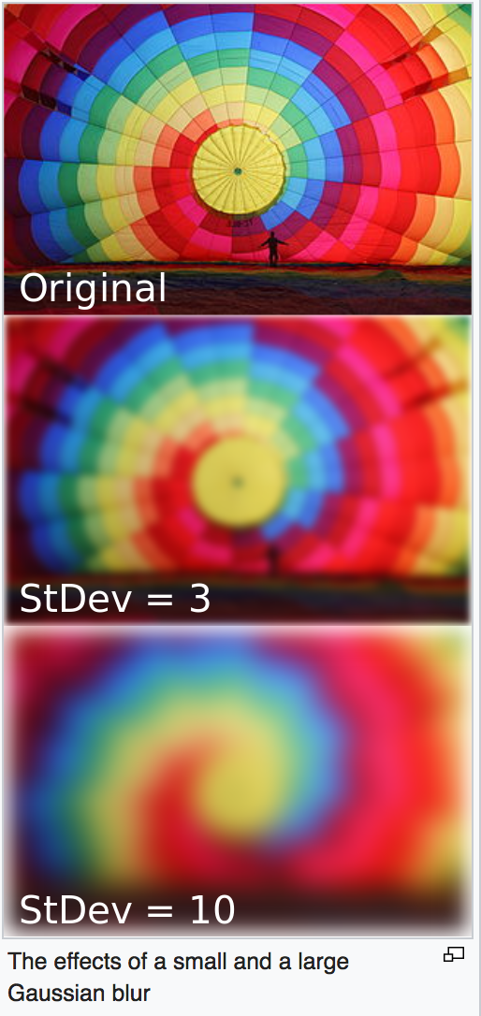
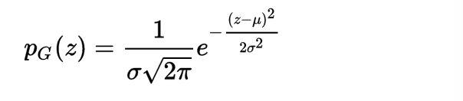


Adding Gaussian noise to the original image
Generating adversarial examples using the fast gradient sign method
The generalization of adversarial examples across different models can be explained as a result of adversarial perturbations being highly aligned with the weight vectors of a model, and different models learning similar functions when trained to perform the same task.
The probability density function p of a Gaussian random variable z is given by:
where z represents the grey level, $μ$ is the mean value and $σ$is the standard deviation.
We added such noises into the original images, and trained these new images with neural networks.
Fast gradient sign method:
with J the cost used to train the neural network, θ is the model parameters, and y is the label of x.
Notes:
First, we use fast gradient sign method to generate adversarial examples. Besides, in order to get a deeper understanding of adversarial example, we also added Gaussian noises to images to make comparison. Again, we will not explain in detail about their concrete measures, which have been shown above.

Slide 5
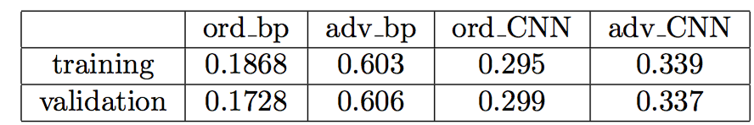
Adversarial training
80%
What is adversarial training?
Adversarial training isn’t acutely trained on adversarial examples. It works by adding an adversarial loss to our original cross entropy loss and count two losses equally towards our ﬁnal loss function. For each batch, compute the cross entropy loss as usual, use fast gradient sign method to generate adversarial examples, and compute the cross entropy loss of the adversarial examples. Take the mean of the two cross entropy losses as the ﬁnal loss function we try to minimize.
Results:
classifier accuracy for ordinary training
Adversarial Training Results for BP and CNN on Adversarial Examples
Conclusion: perform better on adversarial training!
Notes:
After generating adversarial examples, we moved on to adversarial training step. It works by adding an adversarial loss to our original cross entropy loss and count two losses equally towards our ﬁnal loss function. Our results show that for BP neural nets, the training and validation accuracy improve a lot: from around 18% to 60%. For CNN, the accuracy only improves 3%. It seems like CNN did not perform well on adversarial examples. However, it has a higher accuracy with random noise after adversarial training.

Slide 6
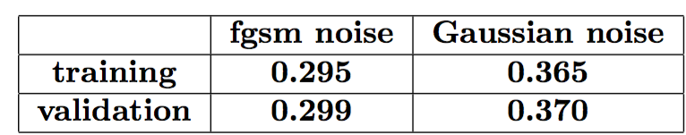
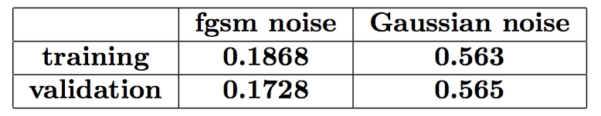
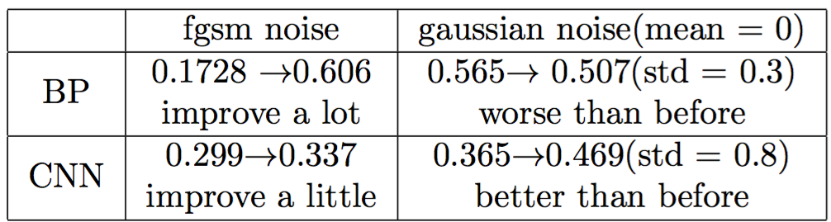
Results
vs
classifier accuracy after adding noise for CNN neural nets.
classifier accuracy after adding noise for BP neural nets.
conclusion
Adversarial Training Performance for BP and CNN
Notes:
In addition, we also compared two kinds of noises with both CNN and BP neural nets. Our results show that both noises will cast huge influence on classification’s accuracy, but models are more robust to Gaussian noise compared with adversarial examples. Moreover, with adversarial training, BP net performs better on adversarial examples, while CNN does better in making correct classification with Gaussian blur.

Slide 7
N
2
Thank you!
Notes:
Well, that’’s all about our findings for now. Thanks for your listening!

